Slide 1
Module 2: Computer-System Structures
计算机系统结构
Computer System Operation
计算机系统操作
Storage Structure
存储结构
Storage Hierarchy
存储层次
Hardware Protection
硬件保护

Slide 2

Computer-System Architecture
计算机系统体系结构
Notes:
Page 6

Slide 3
Computer-System Operation
计算机系统操作
I/O devices and the CPU can execute concurrently.
I/O 设备与CPU可并行运行
Each device controller is in charge of a particular device type.
每一设备控制器负责一个设备类型
Each device controller has a local buffer.
每一设备控制器有一局部缓存
CPU moves data from/to main memory to/from local buffers
CPU 通过局部缓存与主存交换数据
I/O is from the device to local buffer of controller.
I/O从设备到设备控制器的局部缓存
Device controller informs CPU that it has finished its operation by causing an interrupt.
设备控制器通过引起中断通知CPU操作已完成

Slide 4
中断机制
hardware interrupt硬件中断
  device controller informs CPU that it has finished its operation by causing an interrupt
    disk, timer, etc.
software interrupt (trap)软件中断（陷阱）
  a trap (or an exception异常)
    division by zero, invalid memory access
  a system call 系统调用(also called a monitor call)
    read( ), write( )

Slide 5
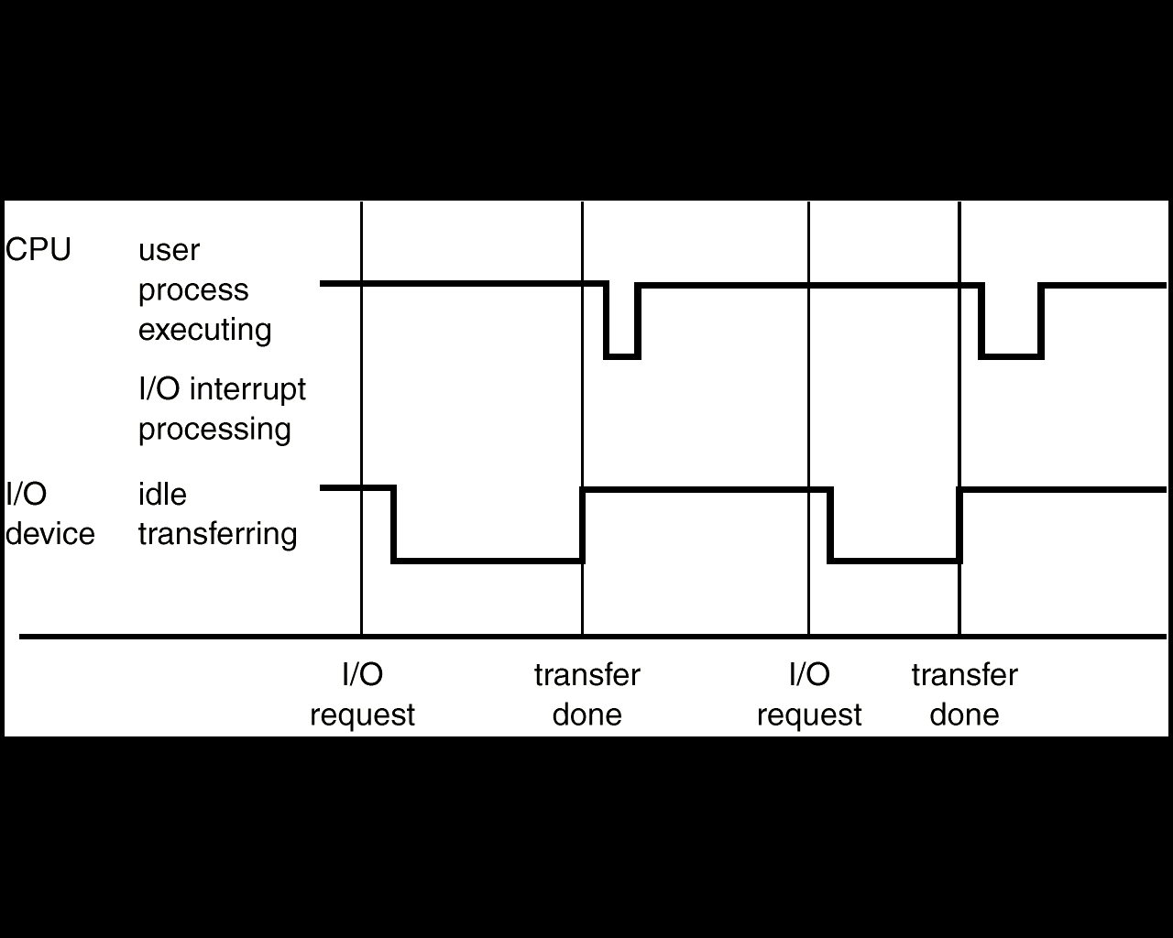
Why the interrupt?
make the system more efficient and meanwhile more responsive

Slide 6
common functions of interrupts
a modern operating system is interrupt driven
现代操作系统是中断驱动的
interrupt transfers control to the interrupt service routine (interrupt handler) generally
中断将控制权转移到中断服务程序
  separate segments of code determine what action should be taken for each type of interrupt
  a generic routine to examine the interrupt information, and in turn call the specific handler
  through the interrupt vector, which contains the addresses of all the service routines
    e.g. MS-DOS, UNIX

Slide 7
中断向量是中断服务程序的入口地址。
将所有中断向量集中放在一起，形成中断向量表。8086系统有256个类型的中断源。每个类型对应一个中断向量,一个中断向量由四个字节组成：2个高地址字节：存放中断服务程序的代码段的段值；2个低地址字节：存放中断服务程序的偏移地址。中断向量表放在内存的地段地址0单元开始的单元:00000H~03FFFH。

Slide 8
中断向量 中断号 中断用途
00 ~ 03 0 除法溢出中断
04 ~ 07 1 单步(用于DEBUG)
08 ~ 0B 2 非屏蔽中断(NMI)
0C ~ 0F 3 断点中断(用于DEBUG)
10 ~ 13 4 溢出中断
14 ~ 17 5 打印屏幕
18 ~ 1F 6,7 保留

Slide 9
I/O Structure
peripheral device(s) attached to device controller设备与设备控制器相连
a device controller (hardware)
  local buffer storage 本地缓冲器
  a set of registers 一组寄存器
device driver, usually a software program embedded into an OS设备驱动程序
Notes:
Page 10

Slide 10
I/O Interrupts
two ways of an I/O operation 两种I/O操作
  Synchronous 同步
  Asynchronous异步
synchronous I/O mode: after I/O starts, control returns to user program only upon I/O completion
asynchronous I/O mode: after I/O starts, control returns to user program without waiting for I/O completion
  the user program will be notified about the I/O completion on a later time
    Windows message, or call back function

Slide 11

synchrounous asynchrounous

Slide 12
synchronous I/O
busy wait method 忙等方式
  wait instruction idles the CPU until the next interrupt
  wait loop (contention for memory access)
    Loop: jmp Loop
  drawbacks: at most one I/O request is outstanding at a time, no simultaneous I/O processing
interrupt based method: multiple I/O 中断方式
  device-status table contains entry for each I/O device indicating its type, address, and state
  a wait queue (a list of waiting requests) for each I/O device

Slide 13

device-status table & wait queue

Slide 14
DMA structure
low speed device like a typical terminal input device leaves most CPU time for other operations
  usually assigned a low interrupt priority, allowing other more important interrupts to be processed first
high-speed I/O devices able to transmit information at close to memory speeds
  if the CPU needs to respond to each interrupt for every byte, it does not have much time for process execution

Slide 15
Direct Memory Access
DMA - device controller transfers blocks of data from buffer storage directly to main memory without CPU intervention设备控制器在本地缓冲和内存之间直接传输一整块数据而无需CPU干预
  setting up buffers, pointers, and counters
  only one interrupt is generated per block, rather than the one interrupt per byte
DMA controller steals memory cycles from CPU DMA控制器从CPU中窃取内存周期

Slide 16
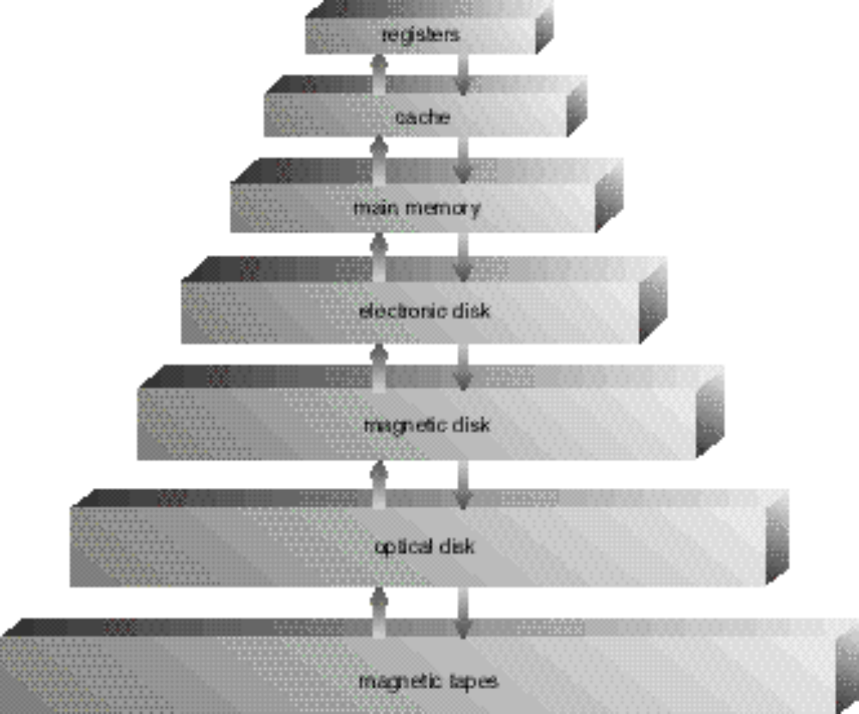
Storage-Device Hierarchy
存储设备层次
speed
寄存器
缓存
主存储器
电子盘
磁盘
光盘
磁带
cost
capacity
Notes:
Page 8

Slide 17
Storage systems organized in hierarchy.存储系统分层组织
  Speed 速度
  cost 成本
  volatility 易失性

Slide 18
Main Memory
random access memory (RAM, DRAM)
main memory are the only large storage that the CPU can access directly CPU可以直接访问的唯一大型存储介质
store data and instructions
problems with RAM
  not big enough, too small to store all programs and data needed permanently 不够大
  volatile, contents lost when power is turned off
  易失性
Notes:
Page 9

Slide 19
Secondary Storage
extension of main memory主存的扩展
  big enough
  non-volatile, permanent提供了非易失的存储容量
magnetic disk磁盘-覆盖了磁记录材料的硬金属或玻璃盘片
  random access
magnetic tape
  sequential access
floppy disks, CD-ROMs, etc.
    data exchange (small and light, easy to carry)

Slide 20

Moving-Head Disk Mechanism
磁头移动机制

Slide 21
cache
use of high-speed memory to hold recently-accessed data使用高速存储保存近期访问的数据
  cache (built into CPU)
  data cache
  instruction cache, code cache
cache management
  locality
  above 80% hit ratio
caching introduces another level in storage hierarchy, and it requires data that is simultaneously stored in more than one level to be consistent

Slide 22
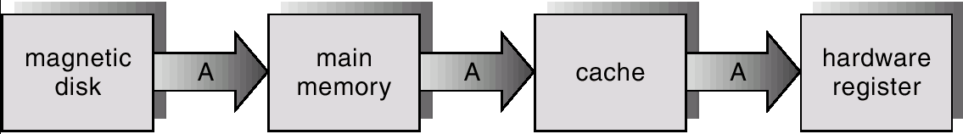
coherency and consistency
the copy of a datum appears in many levels of storage hierarchy
  single process, easy
  multiprogramming environment
  multiprocessor environment
    cache coherency, handled by hardware
  distributed environment

Slide 23
Storage Hierarchy
存储层次
Caching – copying information into faster storage system; main memory can be viewed as a last cache for secondary storage.
缓存- 把信息复制进较快的存储系统；主存可看作为二级存储器的最后一个缓存

Slide 24
Hardware Protection
硬件保护
single-user programmer-operated system, complete control of the computer system, no protection单用户系统，程序员可完全控制系统
early OS, called resident monitor, still no protection 早期OS称为常驻监督程序，没有保护
batch system, need some protection
  e.g. an indefinite loop reading cards不断读取卡片
multiprogramming, a program may accidentally or deliberately/maliciously modify the code or data of another program
Notes:
Page 18

Slide 25
Hardware Protection
硬件保护
multi-user environment, need protection for files, data on disk/tape 多用户环境，需要保护磁盘上的文件、数据
hardware trap to the OS, when 硬件陷入到OS当
  illegal instructions, or access memory not in the address space, etc.非法指令，或访问不属于自己的地址空间的内存
  process terminated/aborted, core dumped 进程终止
Dual-Mode Operation 两状态操作
I/O Protection I/O保护
Memory Protection 内存保护
CPU Protection CPU 保护

Slide 26
Dual-Mode Operation
两状态操作
Sharing system resources requires operating system to ensure that an incorrect program cannot cause other programs to execute incorrectly.
共享系统资源要求操作系统确保有误程序不会引起其他程序的运行错误
Provide hardware support to differentiate between at least two modes of operations.
至少在两个运行状态之间提供硬件支持
  1. User mode – execution done on behalf of a user.
  用户态-代表用户执行
  2. Monitor mode (also supervisor mode or system mode) – execution done on behalf of operating system.
  管态（特权模式或系统模式）-代表操作系统执行
Notes:
Page19

Slide 27
Dual-Mode Operation
mode bit added to computer hardware to indicate the current mode: monitor (0) or user (1)
模式位添加到计算机硬件，表示当前模式
  mode bits in PSW
at boot time, the hardware starts in monitor mode 系统引导时，硬件处于管态
starts user processes in user mode 在用户模式下执行用户进程

Slide 28
when an interrupt or fault occurs hardware switches to monitor mode出现中断或陷阱，硬件切换到管态
dual-mode protect OS from errant users, and errant users from one another
Interrupt/fault
monitor
user
set user mode
Privileged instructions can be issued only in monitor mode

Slide 29
privileged instructions:特权指令 change mode, I/O
  in user mode: always change mode to kernel
    the way to implement system call
    arguments passed via registers, stack, or memory (with pointers in registers or stack)
  in kernel mode: just do it!

Slide 30
I/O Protection
all I/O instructions are privileged instructions所有的I/O指令都是特权指令
  memory mapped I/O, disk I/O (file access), display I/O, printer I/O, network I/O
  a user cannot issue I/O instructions directly, he must do it through system call用户不能直接用i/o指令，必须通过系统调用
it must be ensured that a user program could never gain control of the computer in monitor mode确保用户程序不能在管态下控制计算机
  e.g., a user program that, as part of its execution, stores a new address in the interrupt vector
    a way to inject a virus or Trojan horse on DOS system

Slide 31

Use of a system call to perform I/O

Slide 32
Memory Protection
must provide memory protection
  at least for the interrupt vector and the interrupt service routines必须保护中断向量和中断服务程序
in order to have memory protection, add two registers that determine the range of legal addresses a program may access确定进程能访问的合法空间
  base register 基址寄存器– holds the smallest legal physical memory address.
  limit register界限寄存器 – contains the size of the range
memory outside the defined range is protected

Slide 33



Slide 34
Memory Protection
every address generated in every instruction in user mode is hardware checked用户态下所生成的每个地址都要经过硬件检查
base and limit registers can be loaded by only the OS by using a special privileged instruction
when executing in monitor mode, the operating system has unrestricted access to both monitor and user’s memory
  change the (base and limit) registers
  load users’ programs into users’ memory
  dump memory map of those programs in case of errors
  access and modify parameters of system calls

Slide 35
CPU protection
we must prevent a program from getting stuck in an infinite loop, or not calling OS services and never returning control to the OS需防止用户程序陷入死循环或者不调用系统服务且不将控制权返回到OS
timer 定时器– interrupts computer after specified period to ensure operating system maintains control
  fixed timer, e.g. 1/32 second
  variable timer, a fixed-rate clock and a counter
    the counter is decremented every clock tick
    when the counter reaches the value 0, an interrupt occurs

Slide 36
The timer
load-timer is a privileged instruction
  before turning over control to the user’s program, the OS ensures that the timer is set to interrupt设定计时器以便产生中断
  if the timer interrupts, control transfers to the OS, and the user program may be killed or given more time to run定时器中断，控制权会返回给OS
timer commonly used to implement time sharing用来实现分时系统
  time slice (every N milliseconds)
timer also used to compute the current time计算当前时间

Slide 37
the goals of the OS must be well defined before the design begins
three vantage points
  services it provides提供的服务
  interface to users and programmers为用户和程序提供的接口
  components and their interconnections各组成部分及其相互连接

Slide 38
Module 3: Operating-System Structures
操作系统结构
Operating System Services操作系统服务
System Calls系统调用
System Programs系统程序
System Components系统部件
System Structure 系统结构
Virtual Machines虚拟机
System Design and Implementation系统设计和实现
System Generation系统生成

Slide 39
Operating System Services
操作系统服务 for user (What can do?)
User interface - Almost all operating systems have a user interface (UI)
  Varies between Command-Line (CLI), Graphics User Interface (GUI), Batch
Program execution – system capability to load a program into memory and to run it. 程序执行 - 调入一个程序进内存并运行之的系统能力
I/O operations – since user programs cannot execute I/O operations directly, the operating system must provide some means to perform I/O.
I/O操作 - 由于用户程序不能直接执行I/O操作，操作系统必须提供手段完成I/O操作
File-system manipulation – program capability to read, write, create, and delete files. 文件系统操作 - 读、写、创建和删除文件的能力

Slide 40
Operating System Services
操作系统服务 for user (What can do?)
Communications – exchange of information between processes executing either on the same computer or on different systems tied together by a network. Implemented via shared memory or message passing.
通信 - 运行的进程在同一计算机或由网络连接的不同系统中交换信息。通过共享存储器或消息传递实现
Error detection – ensure correct computing by detecting errors in the CPU and memory hardware, in I/O devices, or in user programs. 出错检测 - 探测在CPU与内存硬件中，在I/O设备中，或在用户程序中的错误，确保正确运算

Slide 41
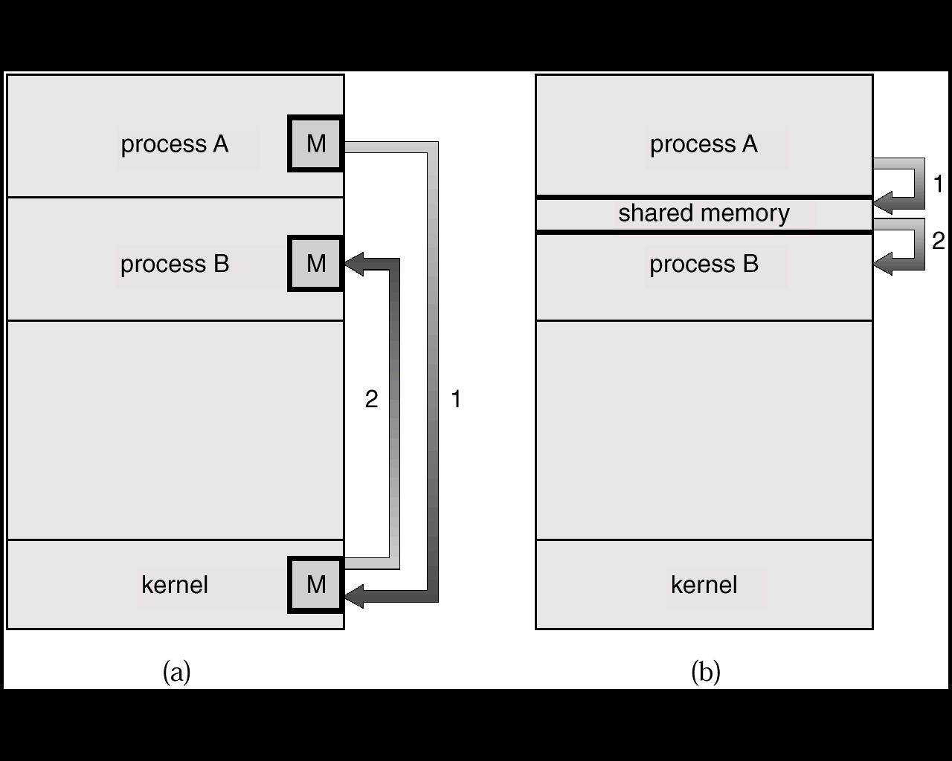
Communication Models
Msg Passing消息传递
Shared Memory共享内存

Slide 42
Additional Operating System Service
其他操作系统服务
Additional functions exist not for helping the user, but rather for ensuring efficient system operations.
其他的功能不是用于帮助用户，而是为了系统效率：
  Resource allocation – allocating resources to multiple users or multiple jobs running at the same time.
  资源分配 - 把资源分配给多个用户或多个同时运行的作业
  Accounting – keep track of and record which users use how much and what kinds of computer resources for account billing or for accumulating usage statistics.
  帐务 - 跟踪和记录用户对资源的使用，用于帐单和统计
  Protection – ensuring that all access to system resources is controlled.
  保护 - 确保对资源的所有访问均在控制中

Slide 43

A View of Operating System Services

Slide 44
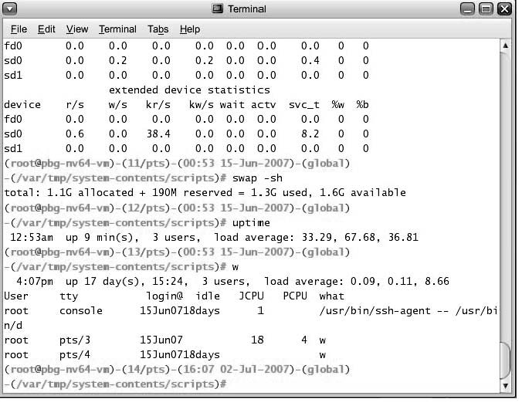
Bourne Shell Command Interpreter
Notes:
在

Slide 45

The Mac OS X GUI

Slide 46
System Calls
系统调用 (How to use?)
System calls provide the interface between a running program and the operating system.系统调用提供在运行程序和操作系统之间的接口
  Generally available as assembly-language instructions.
  通常以汇编语言指令形式提供
  Languages defined to replace assembly language for systems programming allow system calls to be made directly (e.g., C. Bliss, PL/360)替代汇编语言的、供系统编程的语言，允许直接使用系统调用

Slide 47
System Calls
系统调用
Mostly accessed by programs via a high-level Application Program Interface (API) rather than direct system call use
Three most common APIs
  Win32 API for Windows
  POSIX API for POSIX-based systems (including virtually all versions of UNIX, Linux, and Mac OS X)
  Java API for the Java virtual machine (JVM)

Slide 48
Processing of system call
系统调用的处理机构:陷入（TRAP）或异常处理机构
把由于系统调用引起处理机中断的指令称为陷入或异常指令（或称访管指令）

Slide 49
Processing of system call
当用户使用系统调用时，产生一条相应的指令
CPU在执行到该指令时发生中断，发出有关的信号给陷 入处理机构；
处理机构在收到了CPU发来的信号后，启动相关的处理程序去完成该系统调用所要求的功能
在处理系统调用之前，陷入处理机构还需保存处理机现场（PSW、PC、系统调用号、用户栈指针、通用寄存器、用户定义的参数等）

Slide 50
Processing of system call (cont.)
如何找到实现系统调用功能的子程序:入口地址表，每个入口地址与相应的系统程序对应
陷入处理程序用系统调用功能号查找入口地址表,得到该系统程序的入口地址,并执行之
系统调用处理结束后，要恢复处理机现场，从而用户程序可以继续执行

Slide 51
用户程序 陷入处理机构 系统子程序
system call
入口地址表
A0
A1
Ai
An
Sub0
(1)保护处理机现场
(2)取系统调用功能号并据此寻找子程序入口
(3)返回
A0
A1
Ai
An
Sub1
Subi
Subn
系统调用的处理过程

Slide 52

API – System Call – OS Relationship

Slide 53

Standard C Library Example
C program invoking printf() library call, which calls write() system call
Notes:
The standard C library provides a portion of the system-call interface for many versions of UNIX and Linux.
In this instance:
The C library intercepts the printf() call and invokes the necessary system call(s) in the operating system—the write() system call

Slide 54
System Calls
系统调用 (How to use?)
Three general methods are used to pass parameters between a running program and the operating system.
3种常用方式用于在运行程序和操作系统之间的参数传递
  Pass parameters in registers. 寄存器中的参数传递
  Store the parameters in a table in memory, and the table address is passed as a parameter in a register. 参数存在内存的一张表中，表地址
  作为寄存器的参数传递
  Push (store) the parameters onto the stack by the program, and pop off the stack by operating system. 程序把参数压入栈，由操作系统弹出

Slide 55
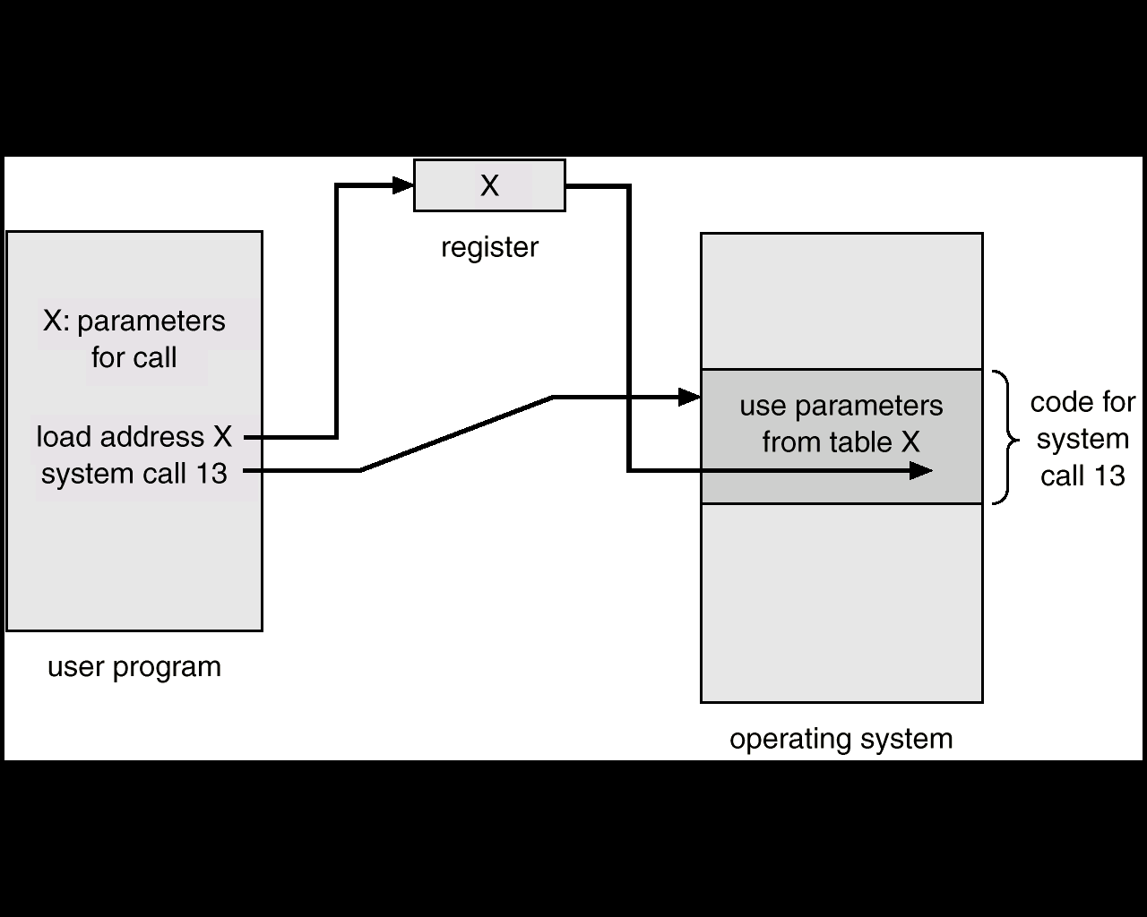
Passing of Parameters As A Table
表格方式的参数传递
Types of system calls Page 56 Figure 3.2

Slide 56
Types of System Calls
process control
  including allocate and free memory
file management
device management
information maintenance
communications

Slide 57

Examples of Windows and Unix System Calls

Slide 58
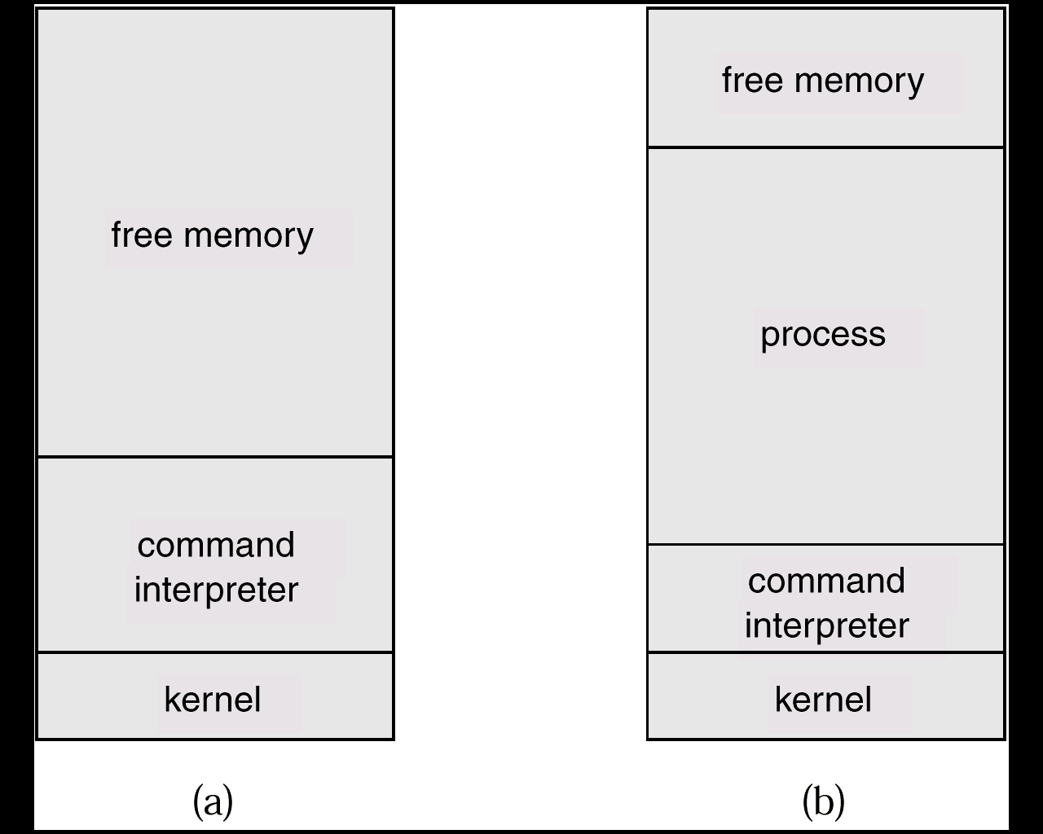
MS-DOS Execution
MS-DOS运行
At System Start-up系统启动
Running a Program运行程序

Slide 59
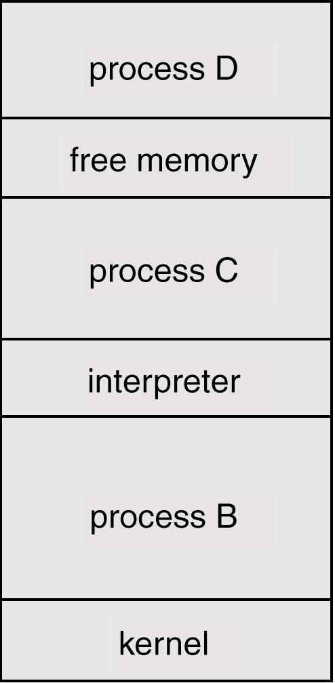
UNIX Running Multiple Programs
UNIX运行多个程序

Slide 60
System Programs
系统程序
System programs provide a convenient environment for program development and execution. They can be divided into:
系统程序提供程序开发和执行的便利环境。可划分为：
  File manipulation-Create, delete, copy, rename, print, dump, list, and generally manipulate files and directories文件操作
  Status information 状态信息
    Date,time, amount of available memory, disk space, number of users
    Detailed performance, logging, and debugging information
  File modification 文件修改
    Text editors to create and modify files编辑器
    Special commands to search contents of files or perform transformations of the text文件内容查找及格式转换

Slide 61
System Programs
系统程序
  Programming language support -Compilers, assemblers, debuggers and interpreters sometimes provided程序设计语言支持
  Program loading and execution - Absolute loaders, relocatable loaders, linkage editors, and overlay-loaders, debugging systems for higher-level and machine language 程序调入和执行
  Communications- Provide the mechanism for creating virtual connections among processes, users, and computer systems通信
  Application programs 应用程序
Most users’ view of the operation system is defined by system programs, not the actual system calls.
大多数用户看到的操作系统由系统程序定义而不是实际的系统调用定义的

Slide 62
Common System Components
系统部件
Process Management 进程管理
Main Memory Management主存管理
Secondary-Storage Management 二级储存器管理
I/O System Management I/O系统管理
File Management 文件管理
Protection System 保护系统
Networking 网络处理
Command-Interpreter System 命令解释器系统

Slide 63
Process Management
进程管理
A process is a program in execution. A process needs certain resources, including CPU time, memory, files, and I/O devices, to accomplish its task.
进程是正在执行的程序。为了完成其任务，进程需要一定的资源，包括CPU时间，存储器，文件，以及I/O设备
The operating system is responsible for the following activities in connection with process management.
在同进程管理有关的活动中，操作系统负责下列事务：
  Process creation and deletion. 进程创建和删除
  Process suspension and resumption. 进程挂起和恢复
  Provision of mechanisms for 可提供以下有关机制:
    process synchronization 进程同步
    process communication 进程通信
  Providing mechanisms for deadlock handling

Slide 64
Main-Memory Management
主存管理
Memory is a large array of words or bytes, each with its own address. It is a repository of quickly accessible data shared by the CPU and I/O devices.存储器是字或字节的一个大数组，每一字或字节有自己的地址。它是一个可被CPU和I/O 共享、可快速存取数据的存放地
Main memory is a volatile storage device. It loses its contents in the case of system failure.主存储器是一个易失性存储设备。系统失败时，会丢失其内容

Slide 65
Main-Memory Management
主存管理
The operating system is responsible for the following activities in connections with memory management:
在同存储管理有关的活动中，操作系统负责下列事务：
  Keep track of which parts of memory are currently being used and by whom.
  保持记录存储器的哪一部分当前被使用以及被谁使用
  Decide which processes to load when memory space becomes available.当有可用存储空间时，决定调入哪个进程
  Allocate and deallocate memory space as needed.
  需要时分配和收回存储空间
  Protection

Slide 66
Secondary-Storage Management
二级存储管理
Since main memory (primary storage) is volatile and too small to accommodate all data and programs permanently, the computer system must provide secondary storage to back up main memory.
由于主存（基本存储器）是易失性的，而且太小不足以永久保存所有的数据和程序，计算机系统必须提供二级存储器备份主存
Most modern computer systems use disks as the principle on-line storage medium, for both programs and data.
多数现代计算机系统采用磁盘作为程序和数据的基本联机存储介质
The operating system is responsible for the following activities in connection with disk management:
在同磁盘管理有关的活动中，操作系统负责下列事务：
  Free space management 空闲空间管理
  Storage allocation 存储器分配
  Disk scheduling 磁盘调度

Slide 67
I/O System Management
I/O系统管理
I/O System Management = Device management
The I/O system consists of: I/O 系统包括
(Hardware and Software)
  A buffer-caching system 缓冲区-高速缓存系统
  A general device-driver interface 通用设备驱动器接口
  Drivers for specific hardware devices 用于特定硬件设备的驱动程序

Slide 68
File Management
文件管理
A file is a collection of related information defined by its creator. Commonly, files represent programs (both source and object forms) and data.
文件是由其创建者定义的关联信息的一个收集器，通常文件表示程序（源程序和目标程序）和数据
The operating system is responsible for the following activities in connections with file management:
在同文件管理有关的活动中，操作系统负责下列事务：
  File creation and deletion. 文件创建和删除
  Directory creation and deletion. 目录创建和删除
  Support of primitives for manipulating files and directories.
  支持操作文件和目录的原语
  Mapping files onto secondary storage.
  把文件映象到二级存储器
  File backup on stable (nonvolatile) storage media.
  在稳定（非易失性）存储介质做文件副本

Slide 69
Protection System
保护系统
Protection refers to a mechanism for controlling access by programs, processes, or users to both system and user resources.
保护是一种机制，控制程序、进程、或用户对系统和用户资源的访问
The protection mechanism must 保护机制必须:
  distinguish between authorized and unauthorized usage. 区分授权和非授权使用
  specify the controls to be imposed. 确定要采用的控制
  provide a means of enforcement. 提供强制手段

Slide 70
Command-Interpreter System
命令解释器系统
Many commands are given to the operating system by control statements which deal with:
操作系统有许多命令，可以通过控制语句处理：
  process creation and management 进程创建和管理
  I/O handling 处理I/O
  secondary-storage management 二级存储管理
  main-memory management 主存管理
  file-system access 文件访问
  protection 保护
  networking 网络

Slide 71
Command-Interpreter System (Cont.)
命令解释器系统
The program that reads and interprets control statements is called variously:
读入和解释控制语句的程序有各种名称
  control-card interpreter 控制卡解释器
  command-line interpreter 命令行解释器
  shell (in UNIX)
Its function is to get and execute the next command statement. 其功能是获得和执行下一个命令语句

Slide 72
System Structure – Simple Approach
系统结构 - 简单结构
MS-DOS – written to provide the most functionality in the least space
MS-DOS-以最小的空间提供最多的功能
  not divided into modules 不划分模块
  Although MS-DOS has some structure, its interfaces and levels of functionality are not well separated
  尽管MS-DOS有某种结构，其接口和功能层没有划分清楚

Slide 73
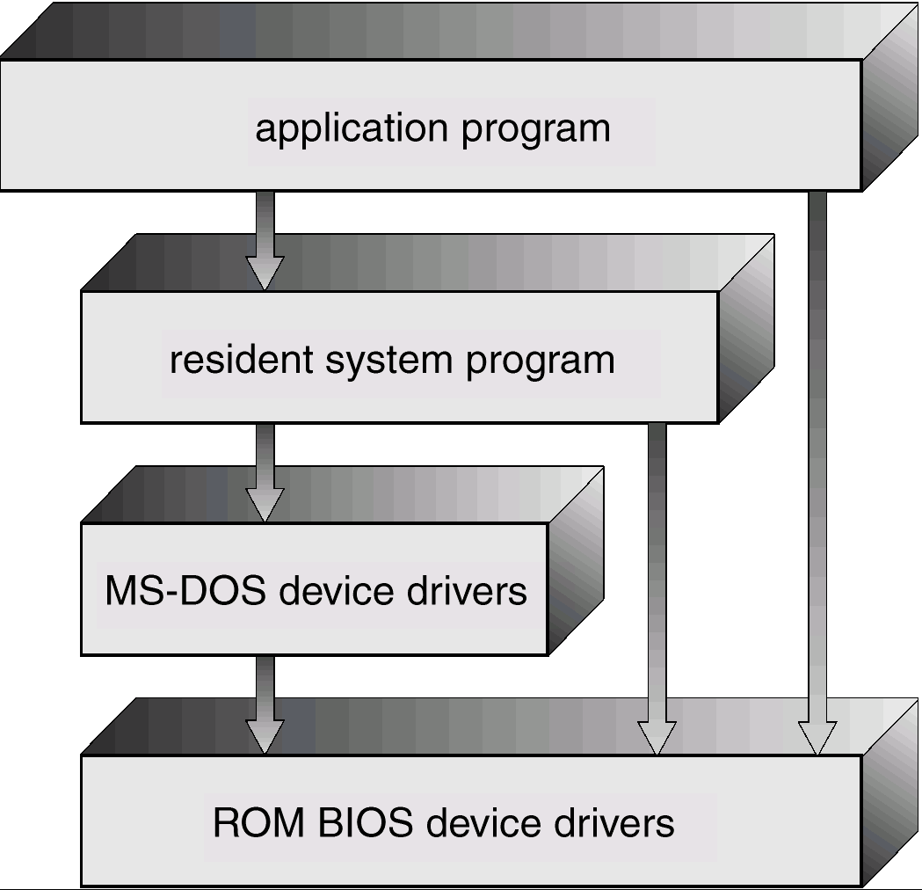
MS-DOS Layer Structure
MS-DOS层次结构
例如，应用程序可直接访问BIOS例程，来直接操纵设备，当然这受限于当时的硬件，intel8088没提供双模式和硬件保护，这使得DOS别无选择只能任由应用程序访问BIOS.

Slide 74
System Structure – Simple Approach 系统结构 - 简单结构
UNIX – limited by hardware functionality, the original UNIX operating system had limited structuring. The UNIX OS consists of two separable parts.
UNIX - 受硬件功能限制，早期UNIX只是有限的结构化。 UNIX包括2个分离的部分
  Systems programs 系统程序
  The kernel 内核
    Consists of everything below the system-call interface and above the physical hardware
    包括了在物理硬件之上，系统调用之下的一切
    Provides the file system, CPU scheduling, memory management, and other operating-system functions; a large number of functions for one level.
    提供文件系统， CPU调度，存储管理，和其他操作系统功能 ；每一层有大量的功能

Slide 75
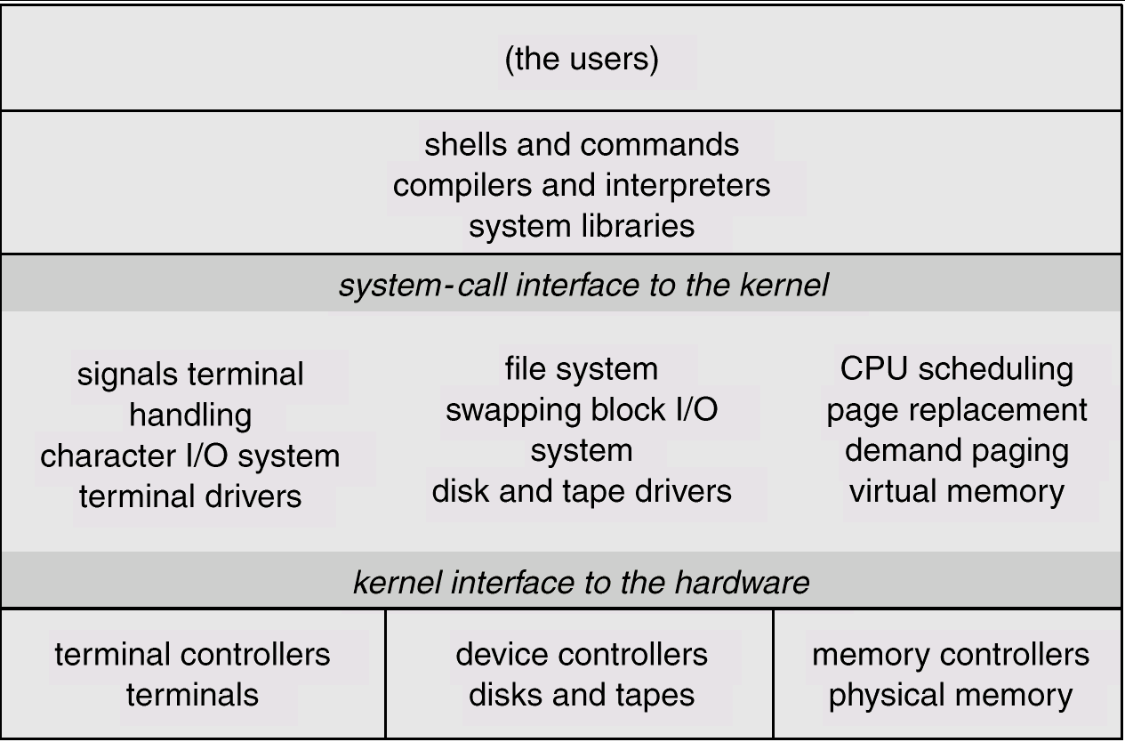
UNIX System Structure
UNIX系统结构

Slide 76
System Structure – Layered Approach
系统结构 - 层次化结构
The operating system is divided into a number of layers (levels), each built on top of lower layers. The bottom layer (layer 0), is the hardware; the highest (layer N) is the user interface.
操作系统划分为若干层，在低层上构建高层。底层（0层）为硬件；最高层（ N层）为用户层
With modularity, layers are selected such that each uses functions (operations) and services of only lower-level layers.
考虑模块化，层的选择是每层只使用低层次的功能和服务

Slide 77

Layered Operating System
分层的基本原则：
  每一层都使用其底层所提供的功能和服务，以便于系统调试和验证。
困难
  层次的划分和安排，要保证不出现双向依赖关系

Slide 78
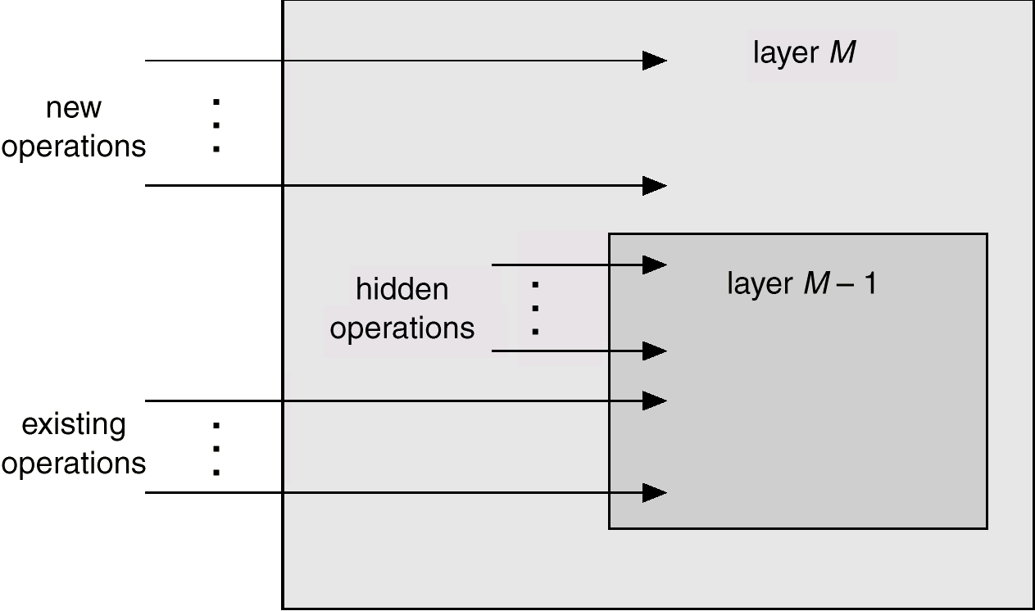
An Operating System Layer
操作系统层

Slide 79
Layered Structure of the THE OS
THE OS的层次化结构
A layered design was first used in THE operating system.
Its six layers are as follows:
THE操作系统首先使用层次化设计。有如下六层：
layer 5:
user programs
layer 4:
buffering for input and output
layer 3:
operator-console device driver
layer 2:
memory management
layer 1:
CPU scheduling
layer 0:
hardware
Notes:
THE操作系统的设计者和开发者; Dijkstra
“死锁”（Deadly embrace）这一术语是Dijkstra发明的。1967年在首届操作系统原理研讨会上，Dijkstra介绍了他和几个博士生研制的THE多道程序系统。THE系统的目的是验证Dijkstra关于操作系统原理、结构、同步进程通信机制等方面的一系列新想法。今天已经普遍采用的系统的多层结构、抽象、上层不需了解下层的详细细节等科学原则就是当时Dijkstra提出的，引起了强烈反响；同步进程通信的信号量Semaphore这一术语也是Dijkstra当时创造的。

Slide 80
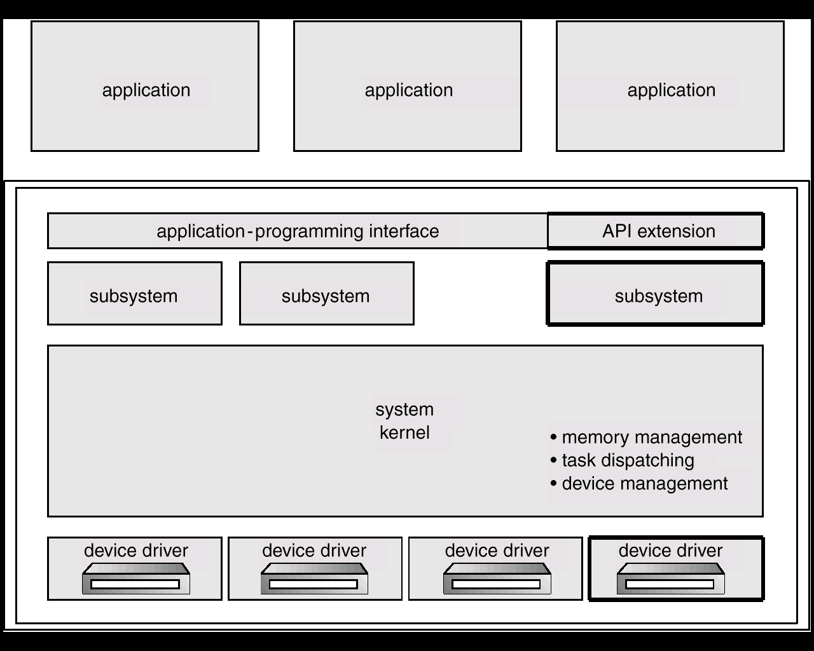
OS/2 Layer Structure
OS/2层次化结构
Notes:
OS/2是由微软和IBM公司共同创造，后来由IBM单独开发的一套操作系统。OS/2是"Operating System/2"的缩写，是因为该系统作为IBM第二代个人电脑PS/2系统产品线的理想操作系统引入的。

Slide 81
Layered Approach
优点
  低层和高层可分别实现（便于扩充）；
  高层错误不会影响到低层，便于调试、利于功能的增删改；
  调用关系清晰（高层对低层单向依赖），避免递归调用，有利于保证设计和实现的正确性
缺点：系统中所有进程的控制转移、通讯等任务全部交给系统的核心去管理，要花费一定的代价

Slide 82
Microkernels
微内核
Mach 首先使用微内核结构
通过划分系统程序和用户程序，把所有不必要的部件移出内核，形成一个小内核
微内核提供最少量的进程管理、存储管理，以及通信功能

Slide 83
Microkernels
微内核
典型系统如MACH和Windows NT
操作系统由两大部分组成
  运行在核心态的内核
  运行在用户态并以C/S方式运行的进程层

Slide 84
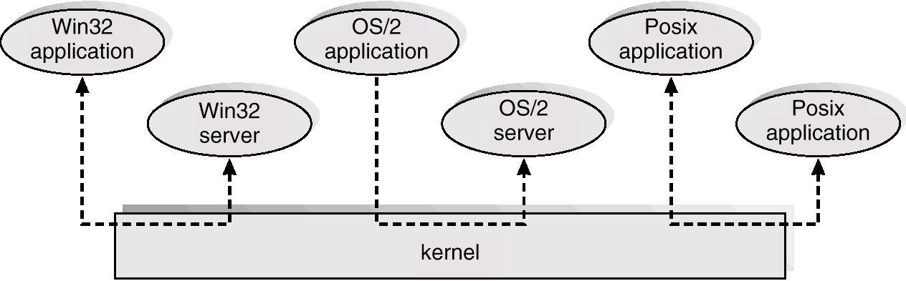
Windows NT Client-Server Structure
Windows NT 客户机-服务器结构
不同的服务 不同的工作方式(历史的原因)

Slide 85
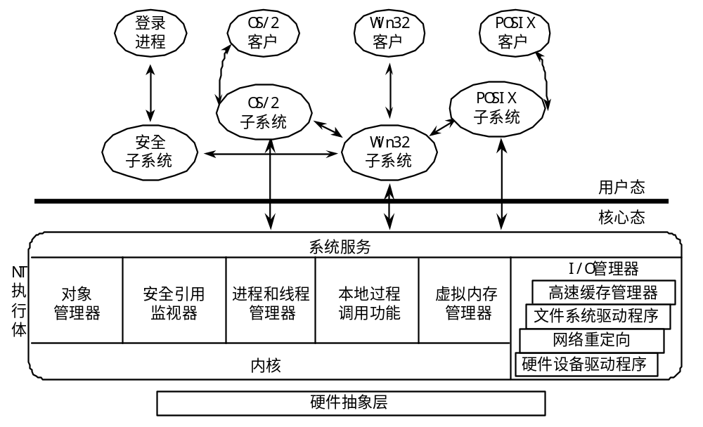
Windows NT体系结构

Slide 86
Microkernels 微内核
基于微内核结构的OS和传统OS相比，具有以下特点：
① 内核精巧．通常内核只由任务管理、虚存管理和进程间通信3个部分组成．传统OS内核中的许多部分都被移出内核．采取服务器方式实现；
② 面向多处理机和分布式系统．基于微内核的OS，在内核中引入了多处理机调度和管理机制，并引入了细粒度并发机制——线程，使得多个处理机可以在同一个任务中并行地执行；
③ 基于客户／服务器体系结构．在微内核结构的OS中，任务间通信机制—— 消息机制是系统的基础，OS的各种功能都以服务器方式实现，向用户提供服务．用户对服务器的请求是以消息传递的方式传给服务器的．

Slide 87
Microkernels
微内核
优点：
  易于扩充，易于移植
  提高系统的可靠性：
  提供多种操作环境
  便于实现分布计算：以同样的调用形式，在下层可通过核心中的网络传送到远方服务器上 (RPC, Remote Procedure Call)
缺点：
消息传递方式增加开销，使响应变慢
几个商品化系统：
  NextStep XINU, OSF/1 1.3,
  Workspace OS, Chorus/Mix V.4
  Mac G3,Windows NT, QNX, CTOS

Slide 88
Virtual Machines
虚拟机
A virtual machine takes the layered approach to its logical conclusion. It treats hardware and the operating system kernel as though they were all hardware.
虚拟机是层次化的逻辑结果。它把硬件和操作系统看成都是硬件
A virtual machine provides an interface identical to the underlying bare hardware.
虚拟机为裸机提供了统一的接口
The operating system creates the illusion of multiple processes, each executing on its own processor with its own (virtual) memory.
操作系统创建了多个进程，每一个进程有自己的处理器和（虚拟）内存

Slide 89
Virtual Machines
虚拟机(Cont.)
实现方式: 分时 共享
The resources of the physical computer are shared to create the virtual machines.物理计算机的资源被共享，以创建虚拟机
  CPU scheduling can create the appearance that users have their own processor. CPU调度使得用户好像有自己的处理器
  Spooling and a file system can provide virtual card readers and virtual line printers. Spooling和文件系统提供了虚拟卡片阅读机和打印机
  A normal user time-sharing terminal serves as the virtual machine operator’s console.普通用户终端成为虚拟机操作员的控制台

Slide 90
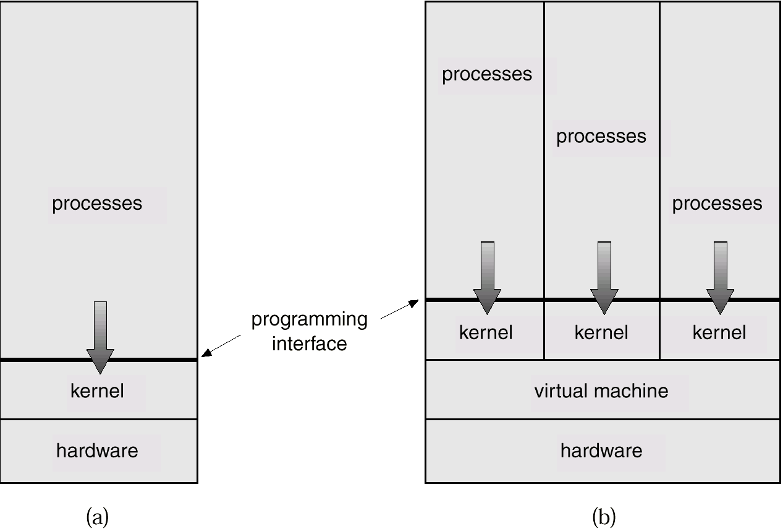
System Models
系统模式
Non-virtual Machine非虚拟机
Virtual Machine虚拟机

Slide 91
Advantages/Disadvantages of Virtual Machines
虚拟机的优缺点
The virtual-machine concept provides complete protection of system resources since each virtual machine is isolated from all other virtual machines. This isolation, however, permits no direct sharing of resources.
虚拟机概念提供对系统资源的完全保护，因为每个虚拟机同其他虚拟机隔离。当然，隔离不允许直接共享资源

Slide 92
Advantages/Disadvantages of Virtual Machines
虚拟机的优缺点
A virtual-machine system is a perfect vehicle for operating-systems research and development. System development is done on the virtual machine, instead of on a physical machine and so does not disrupt normal system operation.
虚拟机是研发操作系统的完美载体。系统开发在虚拟机上而不是在物理硬件上完成，从而不会打扰正常系统运行
The virtual machine concept is difficult to implement due to the effort required to provide an exact duplicate to the underlying machine.
由于需要对下面的机器进行精确的复制，所以虚拟机的概念实现困难

Slide 93
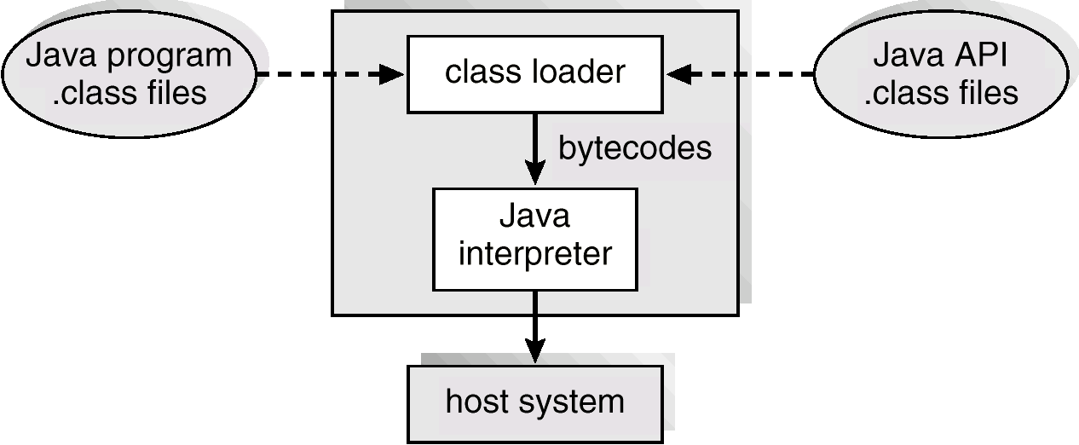
The Java Virtual Machine
Java虚拟机

Slide 94
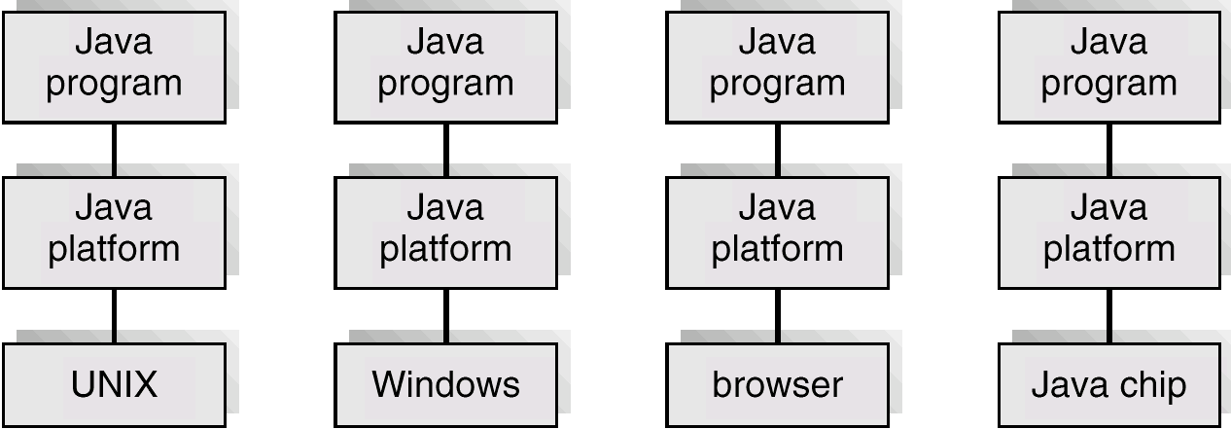
The Java Platform
Java平台

Slide 95
System Design Goals
系统设计目标
User goals – operating system should be convenient to use, easy to learn, reliable, safe, and fast.
用户目标 - 操作系统应该便于使用，易学，可靠，安全并且快捷
System goals – operating system should be easy to design, implement, and maintain, as well as flexible, reliable, error-free, and efficient.
系统目标 - 操作系统应该容易设计、实现和维护，还要灵活、可靠、无错误和高效

